Slide 1
Database Management System
By- Mr. Digvijay A. Patil

Slide 2
DBMS
What is data?
  Data refers to raw facts, figures, or descriptions that can be collected, processed, and interpreted to gain understanding and make decisions. It can take many forms, including numbers, text, images, sounds, and observations, and is often stored electronically for analysis. When processed, organized, and understood within a context, data becomes information.

Slide 3
What is Database
A database is an organized collection of electronic data, often structured in tables with rows and columns, that is designed for efficient storage, access, and management.
Databases are controlled by a database management system (DBMS), which allows users to add, update, query, and organize information using languages like SQL. They are used to store information for a wide range of applications, from personal contacts and social media user data to complex business and financial transactions.

Slide 4
Why Database?
StudentDetails:
  Name
  Roll No
  Address
  Mobile No.
  Age
  Gender
Database

Slide 5
Efficient Data Management: Databases provide a structured way to organize and store vast amounts of data, making it easy to add, edit, or delete records.
Data Integrity and Accuracy: Built-in constraints and validation rules ensure data consistency and prevent duplication and errors, leading to more reliable information.
Scalability: Databases can grow to handle enormous datasets, from small applications to "big data" challenges faced by companies like Google, ensuring they remain effective as data accumulates over time.
Data Security: Access controls, user authentication, and encryption protect sensitive information from unauthorized access, ensuring confidentiality and compliance with regulations.
Multi-User Access: Multiple users can access and modify the same database simultaneously without creating conflicts or inconsistencies, promoting collaboration.
Faster Data Retrieval: Sophisticated indexing and query capabilities allow for swift and precise retrieval of specific information from large datasets.
Data Analysis and Insights: Databases empower organizations to analyze data, identify trends, and uncover insights that support informed business decisions.
Backup and Recovery: Databases typically include automated backup and recovery features to protect against data loss in the event of a system failure.
Data Integration: They facilitate data sharing and consistent access across different systems and applications, allowing for the combination of data from various sources.
Reduced Redundancy: By centralizing data, databases minimize duplication, which saves storage space and maintains data consistency across the system.

Slide 6
Data Store Techniques
Books and File System
Flat File System
Database

Slide 7
Flat File System
Data Related Problems
  Data Redundancy: The same data is often duplicated across multiple files, consuming more storage space.
  Data Inconsistency: Due to redundancy, updates to data in one file may not be reflected in others, leading to data being different across the system
  Data Isolation: Data is scattered across various files in different formats, making it difficult to find and access all related information in one place

Slide 8
Access and Usage Problems
  Difficulty in Data Access: Retrieving specific information requires manual searching through files or writing application programs, rather than using efficient query systems
  Lack of Data Integration: It is challenging to combine and relate data stored in different, isolated files, hindering coherent data views
  Program Dependence: The physical structure and file formats are tied to specific application programs, meaning any change to a file structure requires modifying the application
Integrity, Security, and Concurrency Issues
  Data Integrity Problems: Enforcing rules and constraints on data is difficult, as they must be programmed into each application individually
  Security Problems: File-based systems offer limited security controls, making it hard to restrict access to specific data for different users
  Concurrent Access Anomalies: Multiple users trying to access and modify the same data simultaneously can lead to incorrect results and data corruption due to a lack of proper control

Slide 9
Database Model
RDBMS
  Store Data in tabular format (Rows and Columns )
    Oracle , MySql , Postgre Sql etc
NoSQL
  Store data in Unstructured format
    MangoDB , Redis etc…
HDBMS
  Hierarchical DBMS – Data Store like Tree Format(Organizational Structure)
  IBM-Information Management System
Emp 1
Emp 2
Emp 3
Emp 4
Emp 5
Emp 6

Slide 10
Database Model
NDBMS(Network DBMS)
  Data store in graphical structure where node are directly connected with each other
DYP-ATU
Math Dept
Computer Dept
Library
Computer Lib

Slide 11
Database Model
ODBMS
  An Object-Oriented DBMS (OODBMS) is a database management system that stores data as objects, similar to how data is represented in object-oriented programming (OOP) languages

Slide 12
RDBMS
An RDBMS (Relational Database Management System) is software that manages data stored in a relational database, which organizes data into tables (relations) with structured rows and columns.

Slide 13
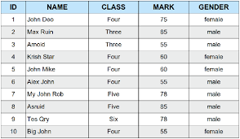
Basic Terminology
Relation - Table/Entity
Tuple – Record
  No Duplicate Tuple
  Must follow same format
Attribute
  Column Name
  Attribute should have name
  Unique attribute – Primary Key
Data Item
  Cell Data
  Automic - Single Value

Slide 14
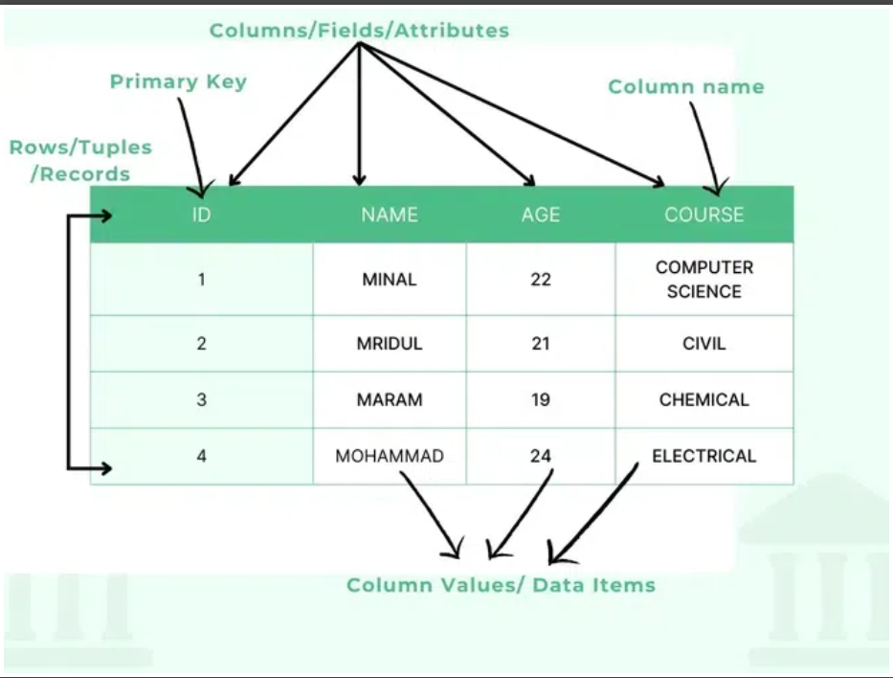
Cardinality
  No. of Tuple / No. Rows
Degree
  No. of Attribute
Domain
  Possible values given to attribute
Null Values

Slide 15
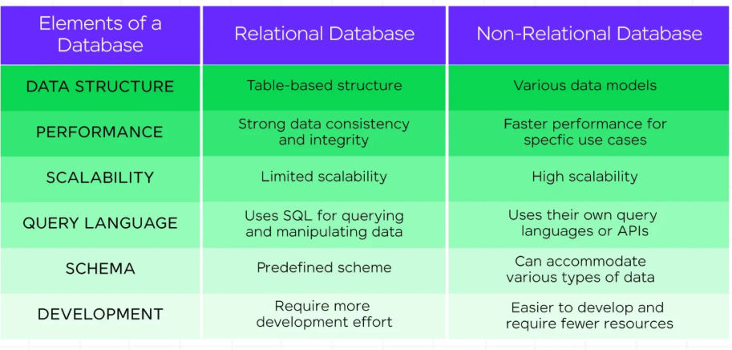
Why RDBMS ?
Difference between Relational Vs Non Relational Database

Slide 16
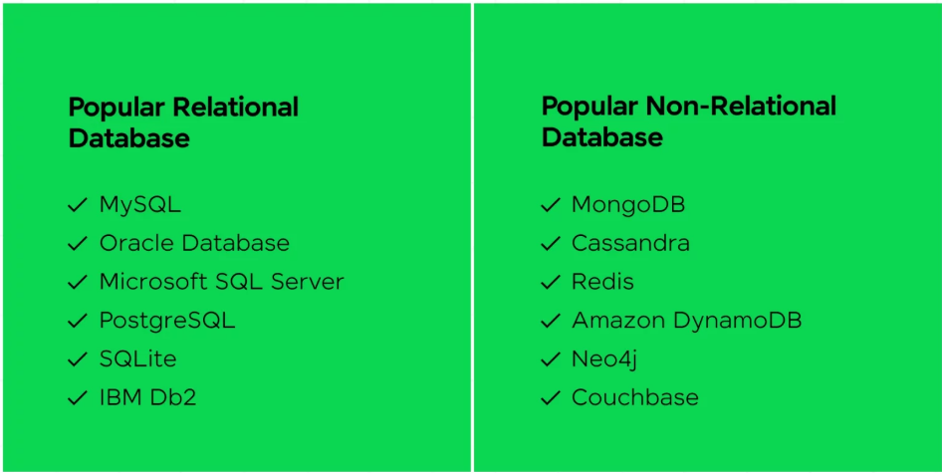
Difference between Relational Vs Non Relational Database

Slide 17
Why RDBMS ?
RDBMS is used for its ability to store large volumes of structured data in an organized, reliable, and accessible way, ensuring data integrity, security, and scalability through features like SQL query language, tabular data storage, ACID properties, and concurrent access for multiple users.

Slide 18
Key Benefits of Using an RDBMS
Data Integrity and Consistency:
  RDBMS enforces data accuracy and reliability through ACID properties (Atomicity, Consistency, Isolation, Durability) and referential integrity via keys, preventing data inconsistencies and errors
Structured Data Management:
  Data is stored in tables with rows and columns, providing a simple, user-friendly, and organized way to manage large datasets
SQL Accessibility:
  The standard Structured Query Language (SQL) makes it easy for users to access, retrieve, update, and manipulate data with simple queries
Reduced Data Redundancy:
  Normalization principles and the use of keys help minimize data duplication and improve efficiency, as changes are made in a central location

Slide 19
Key Benefits of Using an RDBMS
Scalability:
  RDBMS can easily scale to handle growing data volumes by adding more resources, ensuring performance with the help of indexes for rapid sorting
Enhanced Security:
  Multiple security layers, including user authorization and role-based access control, protect sensitive data from unauthorized access
Concurrent User Access:
  RDBMS supports multiple users accessing and modifying data simultaneously, ensuring that multiple users can work together without conflicts
Fault Tolerance:
  Database replication and backup/recovery mechanisms provide fault tolerance, ensuring data availability and system recovery in case of failures or power outages

Slide 20
Constraints
Integrity constraints are rules defined in a database to maintain data accuracy , consistency and reliability
They ensure that data stored in the database follows predefined rules or conditions.

Slide 21
Integrity Constraints
Domain Constraints
Entity Integrity Constraints
Referential integrity Constraints
Key Constraints
Attribute
e.g Student table
Age|Name|MobileNo
-5|ajay |98606166
Check(Age>0)
Entity – Table
Unique Data
Not Null
:
Primary Key
Foreign Key
Parent Table
Child Table
Unique Key
Candidate Key

Slide 22
Candidate Key
Student Table
Adhar Card No
Roll No
Registration No
Phone No
License No
Votar Id
Email
What is Key- Attribute
Use of Key – Uniquely Identify the Attribute
Sname | Age | City
Ajay | 29 | Pune
Raj | 25 | Satara
Ajay | 29 | Pune

Slide 23
Primary Key – {Unique + Not Null}
Roll No. | Sname | Age | City
1 | Ajay | 29 | Pune
2 | Raj | 25 | Satara
3 | Ajay | 29 | Pune

Slide 24
Foreign Key
It is an attribute or set of attribute that references to primary key of same table or another table.
Maintain referential integrity
Student - Roll No (Primary Key)
Course- Course ID (Primary Key)
Roll No. Foreign Key
CREATE TABLE student (
roll_no INT PRIMARY KEY,
name VARCHAR(50),
department VARCHAR(50)
);
-- Referencing (child) table: course
CREATE TABLE course (
course_id INT PRIMARY KEY,
course_name VARCHAR(50),
roll_no INT,
FOREIGN KEY (roll_no) REFERENCES student(roll_no)
);
Roll No. | Sname | Department
1 | Ajay | IT
2 | Raj | Computer
3 | Ajay | E&TC
Course ID | Course name | Roll No.
1001 | DBMS | 1
1002 | Networking | 1
1003 | Java | 3

Slide 25
Super Key
A super key is a combination of all possible attributes which can identify two tuples in the table.

Slide 26
Data Modeling
Conceptualization
Visualization
Representation
Data Standard

Slide 27
Data Modeling
Data modelling in analysis is the process of creating a visual representation , abstraction of data structures, relationships, and rules within a system or organization. Determining and analysing the data requirements required to support business activities within the bounds of related information systems in organisations is another process known as data modelling.
The main objective of data modelling is to provide a precise and well-organized framework for data organisation and representation, since it enables efficient analysis and decision-making. Analysts can discover trends, understand the connections between various data items, and make sure that data is efficiently and accurately stored by building models

Slide 28
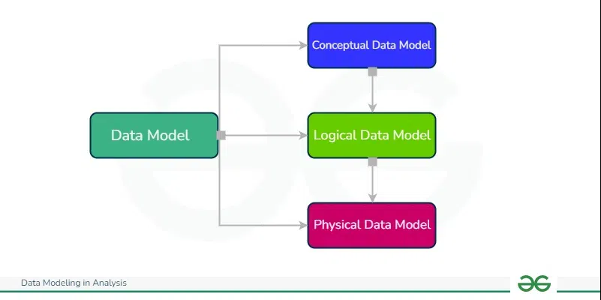
Types
High Level View
What attribute
Business Rules
More Details on concept
Data Types
Primary Attributes
High Level Details
Data Types & Relations
Constraints
Actual implementation

Slide 29
Normalization
It reduces the redundancy of data in a table also removes inconsistency problem and unwanted risk.
It is a technique to Remove or reduce redundancy from a table.

Slide 30
Row and Column Level Duplication are their
Primary Key
Roll No. | Sname | Age
1 | Ajay | 29
2 | Raj | 25
1 | Ajay | 29
SID | Sname | CID | CNAME | FID | Faculty NAME | Salary
1 | Ram | C1 | DBMS | F1 | Raj | 90000
2 | Ravi | C2 | JAVA | F2 | Abhi | 80000
3 | Nitin | C1 | DBMS | F1 | Raj | 90000
4 | Ajay | C1 | DBMS | F1 | Raj | 90000
5 | Vijay | C10 | MBBS
Insertion, Deletion & Updation Anomaly

Slide 31
Normalization
Normalization is the method to breaking down large complex table into smaller , related table and define the relationship between them.
Normalization is the process of organizing data in a database. It includes creating tables and establishing relationships between those tables according to rules designed both to protect the data and to make the database more flexible by eliminating redundancy and inconsistent dependency.
It reduces the redundancy of data in a table also removes inconsistency problem and unwanted risk.

Slide 32
Advantage
Maintain data integrity
Reduce the structure of table
Avoid the NULL Value
Structuring of data show that model is flexible and easy to use

Slide 33
First Normal From (1NF)
Rule- Table should not contain any multi valued attribute
Not in 1st Normal From
Roll No. | Sname | Course
1 | Ajay | C/C++
2 | Raj | Java
3 | Ravi | C/DBMS
Roll No. | Sname | Course
1 | Ajay | C++
1 | Ajay | C
2 | Raj | Java
3 | Ravi | C
3 | Ravi | DBMS
Roll No. | Sname | Course1
1 | Ajay | C++ | C
2 | Raj | Java | Null
3 | Ravi | C | DBMS
Address
Phone
Mobile No.
Roll No. | Sname
1 | Ajay
2 | Raj
3 | Ravi
Course1 | Roll No.
C++ | 1
Java | 2
C | 1
DBMS | 3
C | 3

Slide 34
Closer Method
Candidate Key
R(ABCD)
FD{A ->B , B→C, C→D}
A+ = BCDA
B+=BCD
C+=CD
D+=D
CK={A}
R(ABCD)
FD{A ->B , B→C, C→D, D→A}
A+ = BCDA
B+=BCDA
C+=CDBA
D+=DABC
CK={A,B,C,D}
A determine B
Prime Attribute - The Attribute which will
Used in creating candidate key
Prime Attribute = A,B,C,D

Slide 35
Closer Method
Candidate Key
R(ABCDE)
FD{A ->B , BC→D, E→C, D→A}
=BDCA
E+=EC
AE+=ABCDE
CK={AE}

Slide 36
Functional Dependancy
Determinant X→Y Dependant
X Determines Y
Y is Determine by X
Sid→Sname
Sid | Sname
1 | Ajay
1 | Ajay
Sid | Sname
1 | Ajay
2 | Ajay

Slide 37
Functional Dependency
Determinant X→Y Dependent
X Determines Y
Y is Determine by X
Sid→Sname
Sid | Sname
1 | Ajay
2 | Vijay
Sid | Sname
1 | Ajay
1 | Ajay
Sid | Sname
1 | Ajay
1 | Viajy
Sid | Sname
1 | Ajay
2 | Ajay

Slide 38
Functional Dependency
Types - 1. Trivial
2. Non Trivial
Trivial-
X→Y
Y is subset of X
Sname,PhoneNo.→Phoneno
Types - 1. Trivial
2. Non Trivial
Non-Trivial-
X→Y
Y is not subset of X
Sid→sname
Sid→deptname
Sid→Phone_no
Always Valid

Slide 39
Properties of Functional Dependency
Reflexivity: if Y is subset of X then X→Y
Augmentation : if X→Y then XZ→YZ
Transitive : if X→Y and Y→Z then X→Z
Union : if X→Y and X→Z then X→YZ
Decomposition : if X→YZ then X→Y and X→Z
Psedutransitivity : if X→Y and WY→Z then WX→Z

Slide 40
Second NORMAL FORM(2NF)
RULE-
Table must be in 1NF
All the Non-Prime attribute should be fully functional dependent of Candidate key

Slide 41
Custome ID | Store ID | Location
1 | 1 | Delhi
1 | 3 | Mumbai
2 | 1 | Delhi
3 | 2 | Banglore
4 | 3 | Mumbai
Candidate Key: Customer_ID , Store_ID
Prime Member: Customer_ID , Store_ID
Non Prime Att: Location
Custome ID | Store ID
1 | 1
1 | 3
2 | 1
3 | 2
4 | 3
Store ID | Location
1 | Delhi
3 | Mumbai
2 | Banglore

Slide 42
Second NORMAL FORM(2NF)
RULE-
Table must be in 1NF
All the Non-Prime attribute should be fully functional dependent of Candidate key
  There should be no partial dependency
  Candidadate key = AB
  A→C
  C is Non Prime Attribute

Slide 43
Third Normal From (3NF)
Table or Relation must in 2NF
There should be no Transitive Dependency
Roll_No | State | City
1 | Maharashtra | Pune
2 | Panjab | Mohali
3 | Maharashtra | Kolhapue
4 | Haryana | Ambala
Transitive : if X→Y and Y→Z then X→Z
Prime Attribute → Non-Prime Attribute
Non Prime Attribute → Non-Prime Attribute
CK{Roll_no}
FD : Roll_No → State
State → City

Slide 44
In Functional Dependency L.H.S attribute must be Candidate key
or
R.H.S. Attribute must be prime attribute
R(ABCD)
FD: AB→C , C→D
CK : AB
PA : A,B
NPA: C,D

Slide 45
Boyce Codd Normal Form (BCNF)
In Functional Dependency L.H.S attribute must be Candidate key
or
R.H.S. Attribute must be prime attribute
In Every Functional Dependency L.H.S. Attribute must be Candidate key
Roll No. | Sname | Votal_id | Age
1 | Ajay | P012 | 21
2 | Raj | K11 | 23
3 | Ravi | F011 | 22
CK{Roll_No,Votar_ID}
FD: Roll_No → Sname
Roll_NO→Votar_ID
Votar_ID→Sname
Votar_ID→Age

